Slide 1
Example Deck
Bias Mitigation Training for Recruitment & Hiring Stakeholders
Copyright © 2024 by EdFuel. This work is licensed under a Creative Commons Attribution-NonCommercial-ShareAlike 4.0 International License.2

Slide 2

Agenda
Welcome, Objectives, and Agreements
Community Building
Biases in Recruitment & Hiring
Equitable Recruitment & Hiring Practices
Targeted Work Time
Closing Remarks

Slide 3
Objectives
Identify your biases and acknowledge them
Identify tools to mitigate bias in your recruitment & hiring process
Create or refine the plan to apply best practices to increase the equity of your hiring process

Slide 4
Participation Agreements
Stay engaged and present
Speak your truth
Listen to your body; move when you need to
Expect and accept non-closure and discomfort
Zealously protect the confidentiality of the community
Be mindful of your airtime & support the inclusion of other voices
Conversations stay in the group, strategies go out

Slide 5
Agenda
Welcome, Objectives, and Agreements
Community Building
Biases in Recruitment & Hiring
Equitable Recruitment & Hiring Practices
Targeted Work Time
Closing Remarks

Slide 6

Community Building
What’s your favorite comfort food?
Share one practice you use for prioritization or personal organization when you have a very full plate?

Slide 7
Agenda
Welcome, Objectives, and Agreements
Community Building
Biases in Recruitment & Hiring Process
Equitable Recruitment & Hiring Practices
Targeted Work Time
Closing Remarks

Slide 8
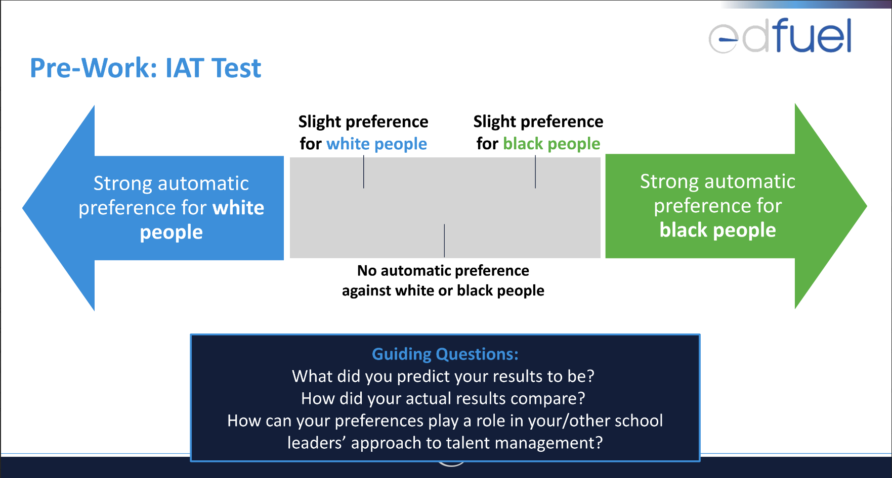
Notes:
https://implicit.harvard.edu/implicit/takeatouchtestv2.html

Slide 9
Some of My Recruitment Biases
I Have a Favorable Bias For Candidates Who...
Have perfectly formatted resumes and strong written communication
Took a traditional path to education
Have systems and data experience like I do (e.g. Salesforce)
Have ties to student and community groups that I have been involved with
I Have an Unfavorable Bias For Candidates Who...
Spell my name wrong in emails
Speak negatively about their current/previous employer
Can’t effectively articulate their passion for education and/or interest in my organization specifically

Slide 10

Identify & Share Your Biases
Use a post-it note to write down:
3 biases that you have when it comes to recruitment & hiring
3 biases that your organization has that you’ve noticed come up repeatedly when hiring new staff
Place each post-it note on the corresponding wall
Take a look at the biases that others post

Slide 11
Biases in Recruitment & Hiring
 | Confirmation Bias
Description | When you explicitly favor, search for, and remember information, personalities, or traits that confirm a belief/hypothesis you already have. As a result, you ignore or forget details that conflict with your belief.
Examples | You look at Tyrone’s resume before you interview him and see he went to an Ivy League school. Then, you find yourself saying “Yup, I knew it!” when he mentions something during the interview corroborating your beliefs about Ivy Leagues.
Bias Busters | Realize that it’s hard to unring the bell and be aware of it – name your biases! Ground yourself in your hiring profile and use that as the lens to assess all candidates in terms of their phone screen notes and in-person interview.
Anchoring Bias
When you lean towards, or away, from candidates that remind you of current and/or former high and low performers.
You admire Sarah and her ability to help your school reach your students with special education needs. Since you want to continue doing so, you need to find another Sarah. When you interview candidates, you only move those forward that remind you of Sarah.
Try and wipe the slate clean by putting all past hiring decisions behind you and hit the reset button. Ask the same set of standard interview questions and ensure you’re allowing your candidates to shine on their own merit.
Note: This list has been revised but originally sourced from Heather Schwager, Founder & Principal at Revive Recruiting.

Slide 12
Agenda
Welcome, Objectives, and Agreements
Community Building
Biases in Recruitment & Hiring
Equitable Recruitment & Hiring Practices
Targeted Work Time
Closing Remarks

Slide 13
10 Ways to Avoid Bias in the Hiring Process
1 | Take your team through a training on bias and ask everyone to authentically and vulnerably share their biases (e.g. IAT as pre-work, hiring bias reflections)
2 | Create a diverse hiring committee; avoid being the only one focused on hiring with a DEI lens!
3 | Create hiring profiles for your opening(s)
4 | Ensure all interview questions you’re asking stem from your hiring profile must-haves
5 | Develop scoring rubrics for interviews and performance assessments
6 | Ask all candidates the same questions and allocate the same amount of time to answer questions
7 | Take unbiased notes/quotes during interviews (ideally in an interview guide or rubric)
8 | Leverage a candidate exercise to assess work product (e.g. demo lesson or performance task)
9 | Rate candidates against your hiring profile immediately following the interview
10 | Conduct at least 3-5 reference checks

Slide 14
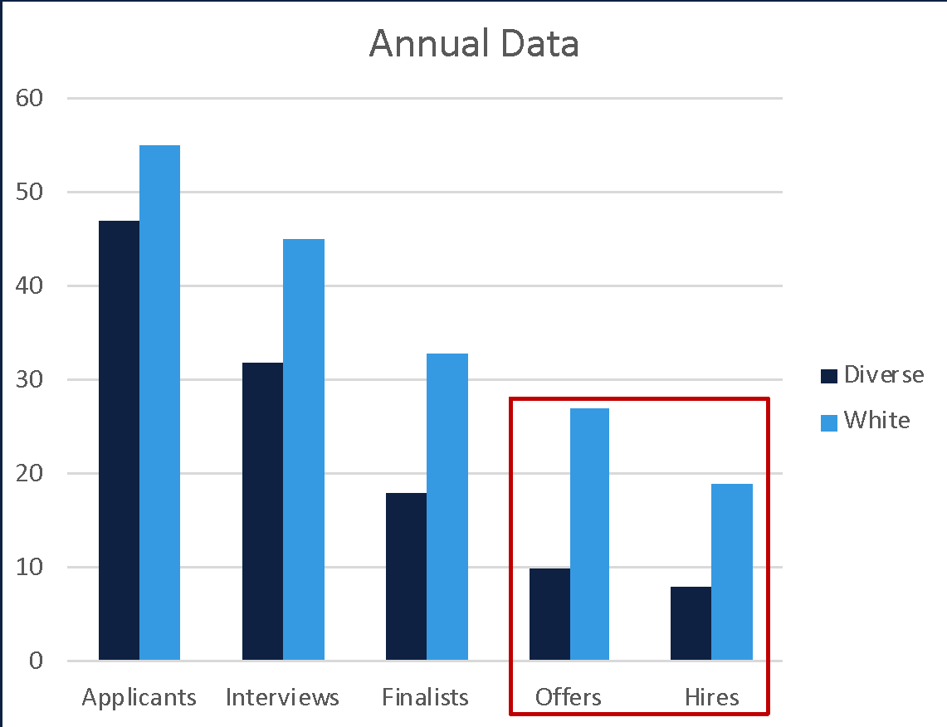
Hiring Committee Training and Development
Acknowledge the Potential for Bias
Create space to acknowledge potential for bias during hiring committee meetings This could include: Data reviews to assess DEIA efforts (e.g. reviewing hiring process data by diversity qualifiers) Open discussions and reflections on bias

Slide 15

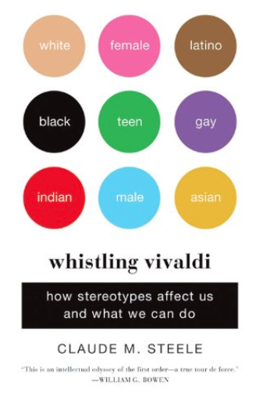
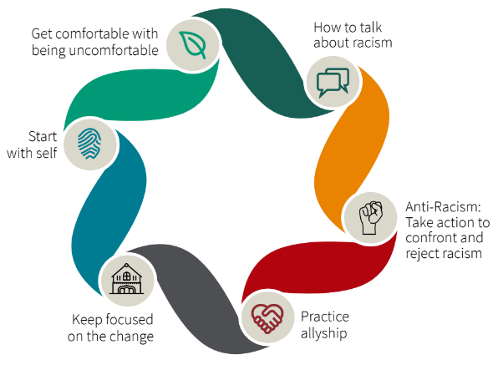
Hiring Committee Training and Development
Build Knowledge Around the Impact of Bias
Be wary of first impressions and understand how they can alter key decisions Resources to norm on shared language (e.g. book club, short podcast) Completing IAT to assess innate preferences Gather input and feedback from diverse staff

Slide 16
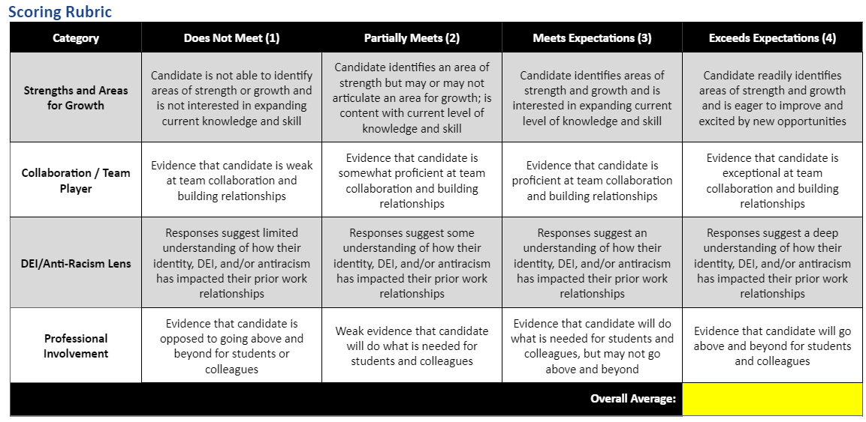
Hiring Committee Training and Development
Apply Best Practices
Utilize hiring profiles and competency maps Norm on interview questions and utilize rubrics Reassess effectiveness via candidate and new hires feedback surveys

Slide 17
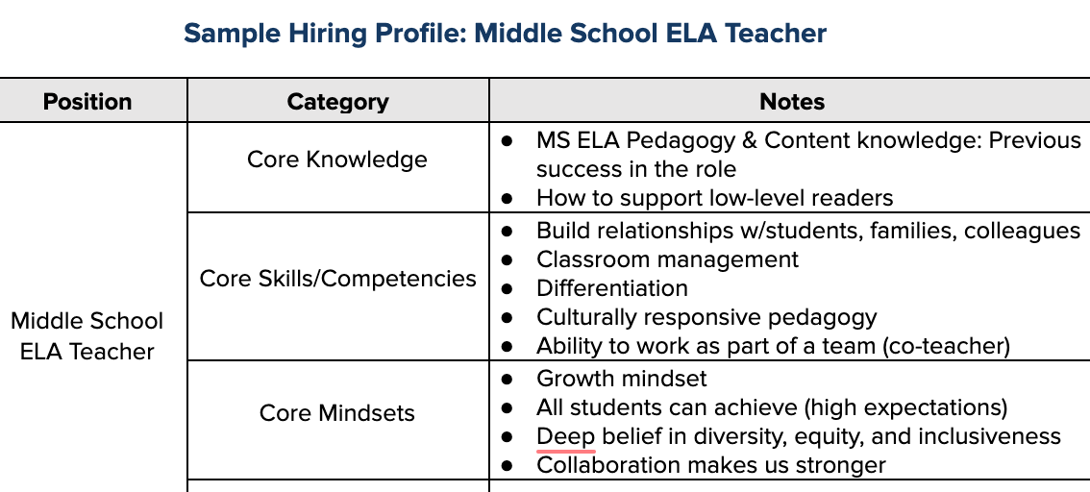
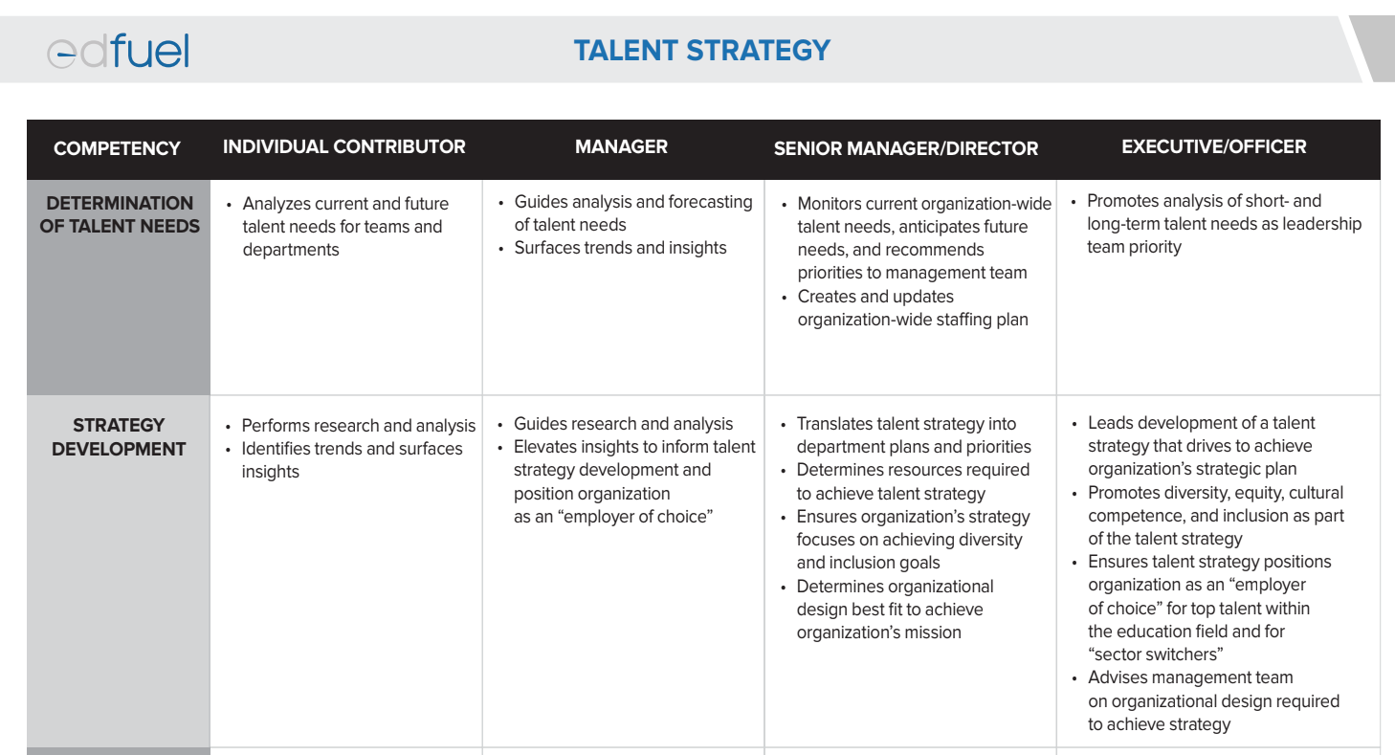
Hiring Profiles and Competency Maps
HIRING PROFILES
Force prioritization
Articulate exact skills/mindsets for the role
Capture short vs. long term needs
Capture non-negotiables vs. growth potential
Can be tailored based on needs of a team, department, etc.
COMPETENCY MAPS
Articulates the competencies (skills, knowledge, behaviors) necessary to achieve success within and across roles in an organization
Conveys how competencies are demonstrated at each level in the organization
Take a few minutes to review the example hiring profiles
and competency maps.

Slide 18
Norm the Candidate Experience:
Equitable, Standard Hiring Process
 | Candidate A | Candidate B | Candidate C | Candidate D
Application | X | X | X
Phone or Video Screen | X | X | X | X
Performance Task | X |  | X
Finalist Interview (Demo Lesson and Debrief) | X |  | X
Reference Checks | X | X |  | X
Hired | X | X |  | X
How might Candidate A feel if they found out the other candidates did not have to complete all steps in the process?
What are some risks with hiring Candidate D?

Slide 19

Norm the Candidate Experience:
Hiring Process Funnel
HIRING PROCESS FUNNEL
Ensure that candidates participate in the same hiring process
Be transparent with hiring timelines and hold hiring managers accountable
Routinely collect feedback from candidates on their hiring process experience
 | All Candidates
Application
Phone or Video Screen
Performance Task
Finalist Interview (Demo Lesson and Debrief)
Reference Checks

Slide 20
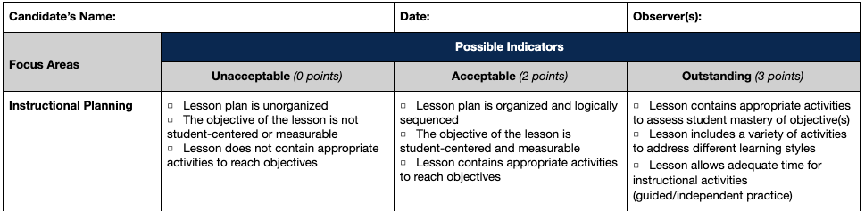
Norm the Candidate Experience:
Standard Questions and Interview Rubrics
STANDARD QUESTIONS
Ensure questions are aligned to hiring profile must-haves
Refrain from asking impermissible questions (e.g. age, race/ethnicity, disability)
Differentiate between priority questions versus additional probing questions
INTERVIEW RUBRICS (PHONE INTERVIEW AND DEMO LESSON)
Remove subjective reasons for rejection (e.g. mission alignment, culture fit)
Take copious notes during interviews (ideally directly into an interview guide or rubric)
Make selections as tangible as possible (e.g. points based on ranking)
Ensure implementation with fidelity by streamlining access and gathering hiring manager investment
Take a few minutes to review the example interview rubrics

Slide 21
Agenda
Welcome, Objectives, and Agreements
Community Building
Biases in the Hiring Process
Equitable Hiring Practices
Targeted Work Time
Closing Remarks

Slide 22
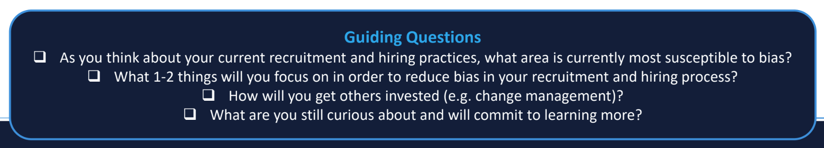
Targeted Work Time
Next Steps for Everyone
Take five minutes to review the equitable hiring resources
Next Steps Based on Your Current Needs
Unpack Your Bias | Align on Current Needs | Systematize the Process
Incorporate bia mitigation strategies into hiring process Adapt anonymous resume reviews for your school and incorporate into hiring process. | Using Hiring Profiles and Competency Maps Review hiring profiles for open roles Access EdFuel’s competency maps | Norming the Candidate Experience Review job description Access hiring tracker Draft standardized interview questions and email communication Agree on assessment rubrics

Slide 23
Agenda
Welcome, Objectives, and Agreements
Community Building
Biases in Recruitment & Hiring
Equitable Recruitment & Hiring Practices
Targeted Work Time
Closing Remarks

Slide 24
Closing Remarks
Regularly assess and reflect your biases to mitigate the impact they have on your hiring decisions.
Share insights into ongoing biases you observe during the hiring process.
Regularly review your school’s DEIA hiring goals to stay aligned with the current process.
Ask questions and stimulate conversation with others!
Thank you!

